Slide 1
Notes (hidden)
Some speakers at Microsoft like to use this slide for hidden “notes slides”.
Delete it if you don’t want to use it.
NEXT: <next slide title>

Slide 2
Microsoft Build

Slide 3
Build your RAG Application with Prompt flow in Azure AI Studio
Azure AI Studio で
RAG アプリケーションを構築するためのプロンプト フロー
Dave Glover
Microsoft
Principal AI Developer Advocate
LinkedIn: gloveboxes
BRK408JP
Notes:
Welcome to the Build a RAG application with Prompt Flow and VS Code
I’m Dave Glover, I’m a AI Developer Advocate, based in Sydney
If looking to build LLM apps then you’ve come along the right session
This is part one of a two parts, be sure to check out BRK411 which dives into evaluation.
My goal is you should have a better understanding of what MS is doing to help you successfully build LLM apps
All source code available along with workshop notes
Introduction in Japan: In Japan, it's customary to start a presentation with a polite and humble self-introduction.
Begin by stating your name, affiliation, and expressing gratitude for the opportunity to speak.
Keep it formal and respectful to align with Japanese cultural norms.

Slide 4
Azure AI Studio の Prompt Flow を使用して RAG アプリケーションを構築
Dave Glover
Microsoft
Principal AI Developer Advocate
LinkedIn: gloveboxes
Notes:
Welcome to the Build a RAG application with Prompt Flow and VS Code
I’m Dave Glover, I’m a AI Developer Advocate, based in Sydney
If looking to build LLM apps then you’ve come along the right session
This is part one of a two parts, be sure to check out BRK411 which dives into evaluation.
My goal is you should have a better understanding of what MS is doing to help you successfully build LLM apps
All source code available along with workshop notes
Introduction in Japan: In Japan, it's customary to start a presentation with a polite and humble self-introduction.
Begin by stating your name, affiliation, and expressing gratitude for the opportunity to speak.
Keep it formal and respectful to align with Japanese cultural norms.

Slide 5
アジェンダ
LLMOps と LLM プロセスの紹介
AI Studio と Prompt Flow
Prompt Flow と VS Code で RAG アプリを構築
LLM アプリの品質を評価でテストする
Notes:
So, here is a taste of what to expect in the session
We’re going to briefly talk about LLMOps
Introduce you to AI Studio and Prompt Flow
The the bulk of the session will be a demo with the new Prompt Flow extension for VS Code
And finish up with a brief look at LLM app quality evaluation

Slide 6
LLM ライフサイクルの活用事例
管理
アプリ展開の準備
プロジェクトの推進
プロンプト エンジニアリングまたは微調整
LLM を探す
取得拡張生成 (RAG)
クォータとコスト管理
安全なロールアウト/ステージング
プロンプトを試す
ビジネス ニーズ
仮説
監視
LLM アプリ/UI の展開
アイデア/ 探索
例外処理
構築/強化
運用化
評価
コンテンツ フィルタリング
プロジェクトを元に戻す
フィードバックを提供する
Notes:
LLMOps is for a new class of LLM Apps. Combination of platform, models, tools, frameworks, best practices
Lots of hard complex problems, and a lot of ongoing research to solve challenges.
We’ve identified 3 phases based on our experiences and customer feedback
Exploring ideas, Model selection, Prompt engineering fits hypothesis
The Building phase to ensuring app quality, hallucinations, performance, customer intent (chat or support), content safety and organization reputation
Operationalizing, Monitoring costs, prompt and response drift and model performance
Wrapped in a Management fabric and set of tools, for eg tools for ci/cd pipelines, enterprise and network security, governance your organization expects

Slide 7
How do we know our results are any good? (2)
LLMのライフサイクルに関する考察
1. アイデア/探索
2. 構築/強化
3. 運用化
ビジネス ユースケースを 特定
サンプル データに対 してフローを実行
より大きなデータセットに 対してフローを実行
エンドポイントのデプロイ
データに接続
Prompt Flow を評価
Prompt Flow を評価
監視とアラートを追加
基本的な
Prompt Flow の構築
Flow の変更 (Prompt やツールなど)
アプリケーションへの統合
機能拡張用の
Prompt Flow を開発
結果に満足
はい
結果に満足
はい
いいえ
いいえ
Notes:
Now let’s look at the 3 stages in a more detail – I want to emphasis this is an iterative process and requires careful evaluation.
1st ideation: the data sources, model selection, prompt engineering
2nd building – run flows against sample data, evaluate/modify prompts and tools, scale data sources, data chunking, search granularity, made more challenging as you’re working with Generative AI
Evaluate evaluate, evaluate
critical to understand how LLM App are being used in the real-world, CI/CD pipelines, A/B testing, and model selection.
Area of ongoing research – I’m going to show an example of using AI to evaluate AI performance
3rd deploying and scaling endpoints, add monitoring and alerts and integrate those endpoints into your applications for real-world use.

Slide 8

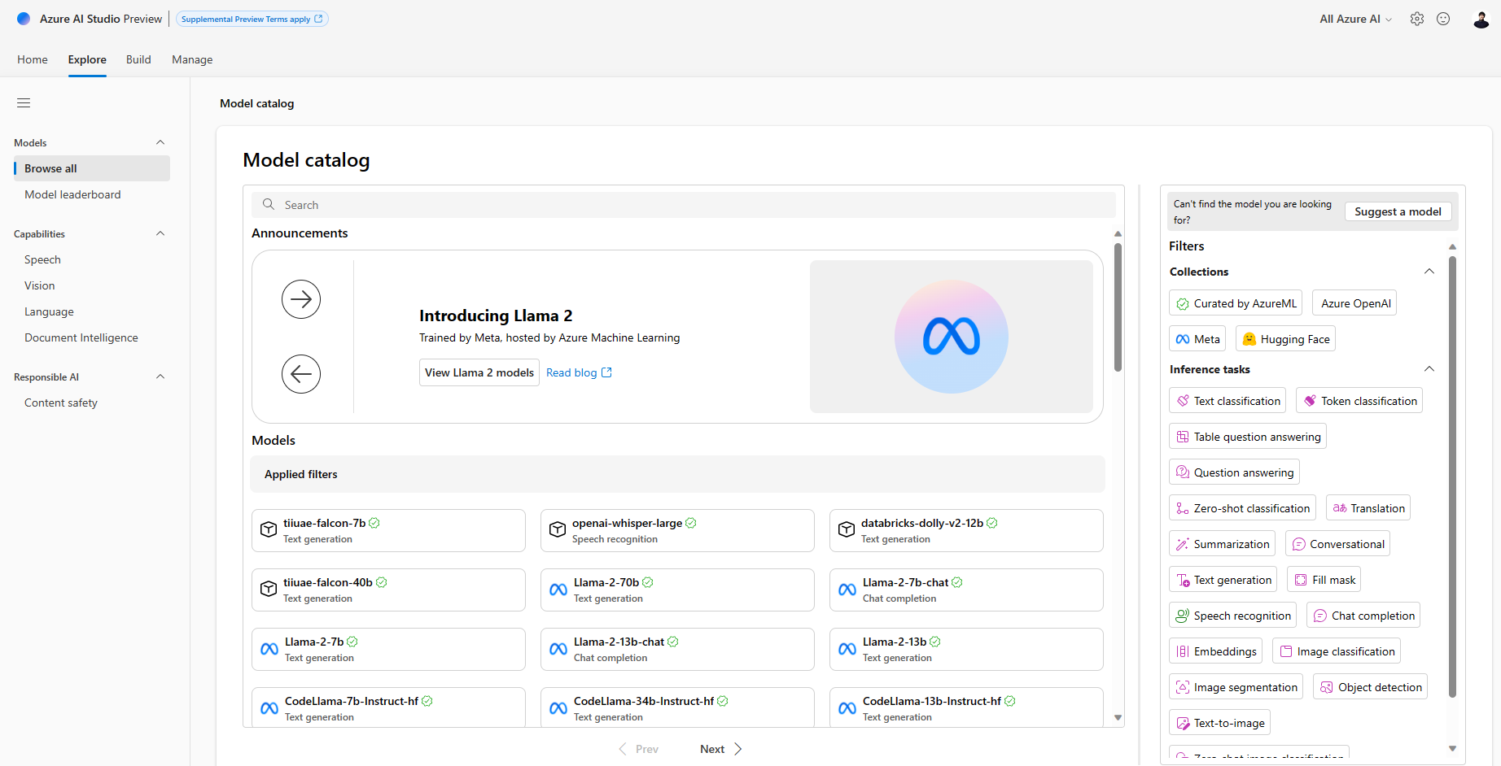
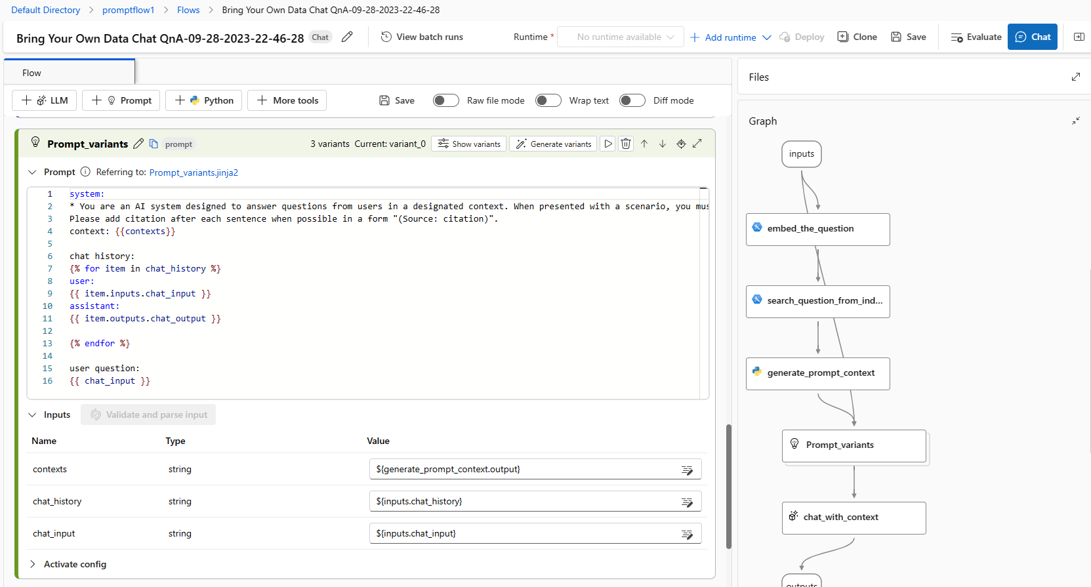
Azure AI は生成 AI の プラットフォーム
OpenAI、Meta、Hugging Face を含む多数の LLM へのアクセス
RAG によるデータ・グラウンディング
Prompt エンジニアリング／評価
安全性と責任ある AI の内蔵
LLM の継続的モニタリング
Notes:
So, in support of the LLM App lifecycle
We are building out platform, tooling, frameworks support
Make it easier to build LLM apps
AI Studio provides
1000s of models
ground models on your structured, unstructured, and real-time data.
Tools for prompt engineering and evaluation
Safety and continuous monitoring
Playground for experimenting

Slide 9
Prompt Flow とは？
視覚化されたグラフを通して、LLM、Prompt、Python をリンクし実行可能なフローを作成
チームコラボレーションにより、フローを簡単にデバッグ、共有、反復
Prompt の変形を作成し、大規模なテストを通じてパフォーマンスを評価
リアルタイム・エンドポイントを導入し、アプリケーションのLLMを監視
LLM アプリケーションの開発サイクル全体を効率化する開発ツール
AI アプリケーションのプロトタイピング、実験、反復、デプロイ、モニタリングのプロセスを簡素化
Notes:
RK451So, what is prompt flow?
Prompt Flow streamlines and simplifies prototyping, experimenting and deployment of LLM Apps
Low code, but extensible, to simplifying building LLM apps
Executable flows linking models, prompts, tools
Debugging and collaboration, source and version control
Create variants and compare performance
Deploy real-time endpoints

Slide 10
Retrieval Augmented Generation（RAG）
ユーザーからの質問
ワークフロー
関連データの取得
レトリーバー・オーバー・ナレッジ・ベース
プロンプトの補強
レスポンスの生成
大型言語モデル
結果の送信
Notes:
One of the keys to successful LLM app is context. I want to talk about two approaches to adding context to LLM apps.
You can fine tune: More complex, more upfront expensive, greater skills required
Now the more popular approach is to augment a prompt with addition context using the RAG pattern
At a high level, this is the basic architecture of a RAG application
This slide has builds: User question -> Retrieve over knowledge base. -> Augment the prompt - Generate the response
This is a very idealized example of RAG as it’s like to be way more complex
customer intent extraction, chat or support, Prompt rewriting, chaining models, safeguards for best output..

Slide 11
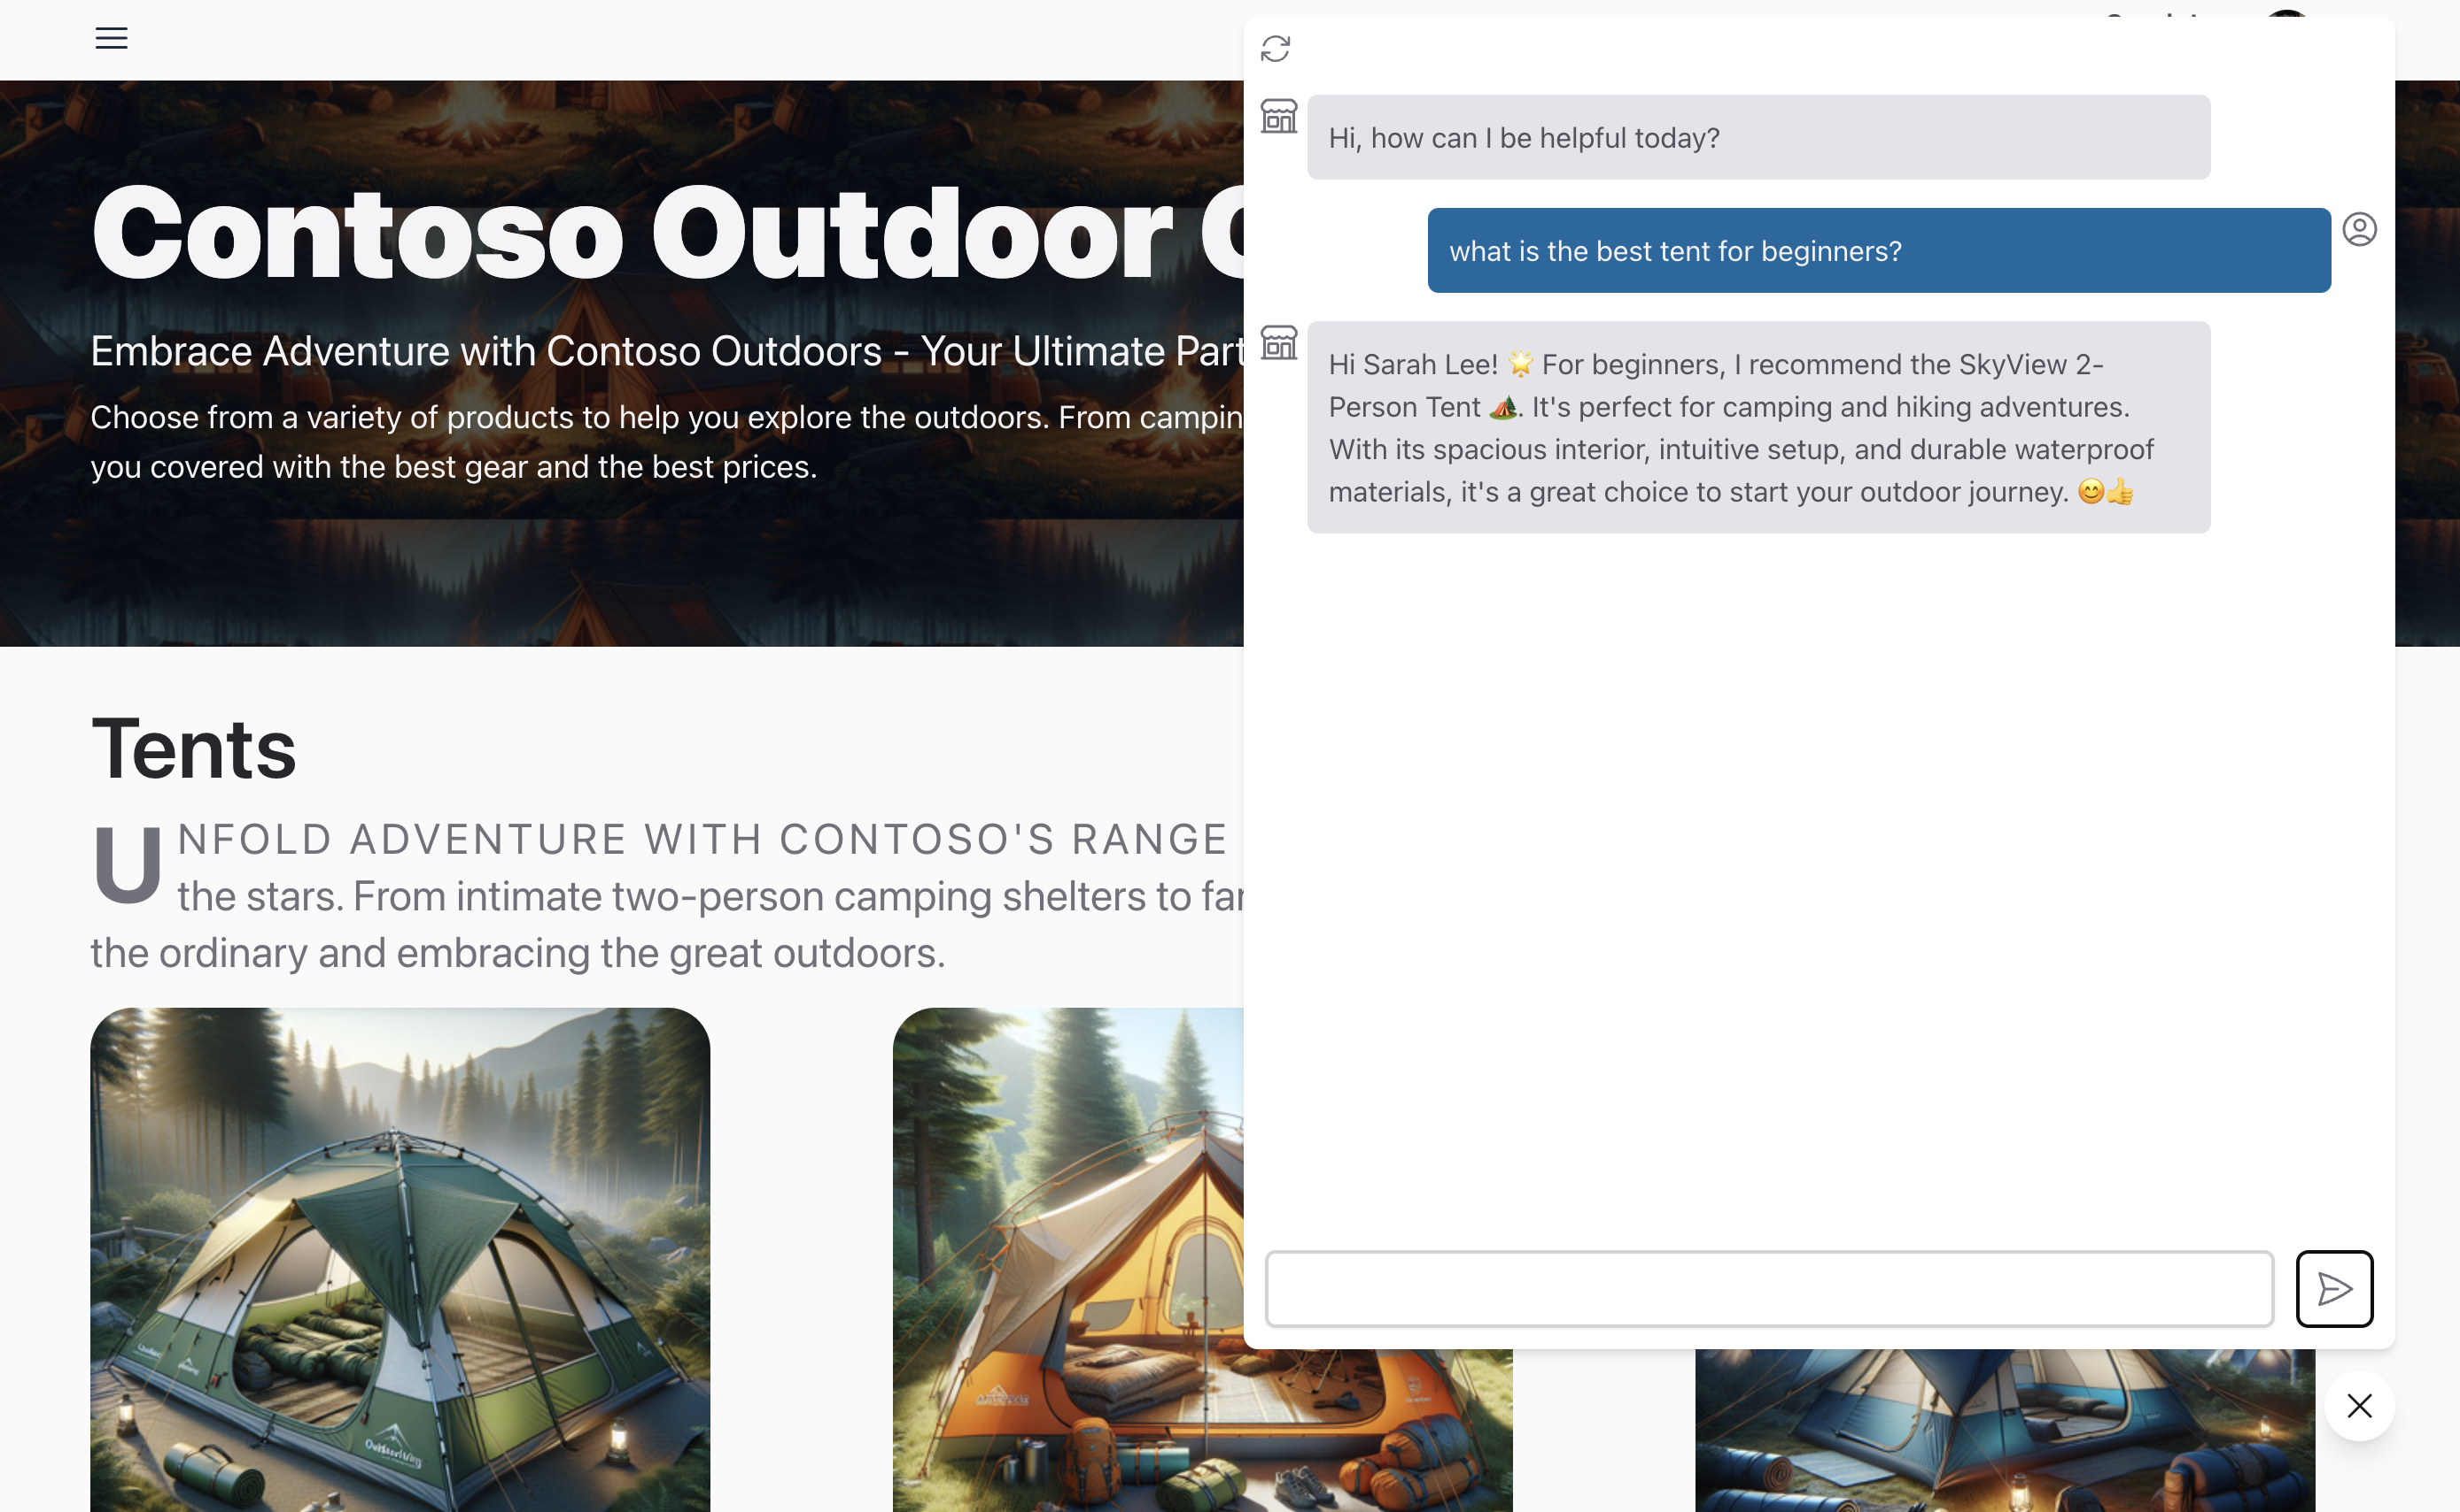
使用例 - Contoso カスタマー・サービス・チャット
ユースケース・リスク
高リスク＝AIとの連携
患者診断
経済的決断
低リスク＝AIによる自動化
カスタマーサポート（引継ぎあり）
情報検索
コンテンツ生成
言語翻訳
教育
Notes:
Next, I want to talk about use cases
So, I would encourage you to think about your use cases through the risk lens
Is the scenario low or high risk
High risk example might be patient diagnostics – you’d want to collaborate with a specialist
Low risk – Information retrieval, or customer support with human handover, Education

Slide 12
Prompt Flow と VS Code によるアイデアの発想と探求
Notes:
Ok, hopefully I’ve set the scene for some of the considerations for LLM app lifecycle and not scared you off completely☺

Slide 13
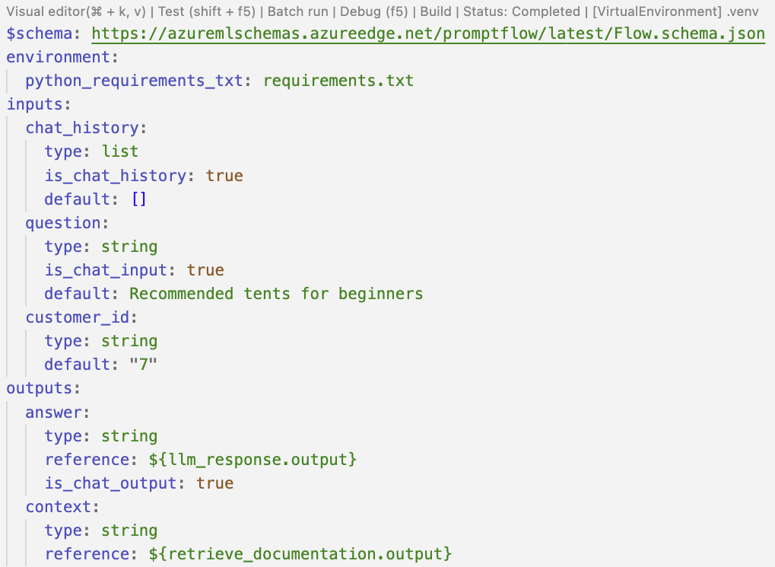
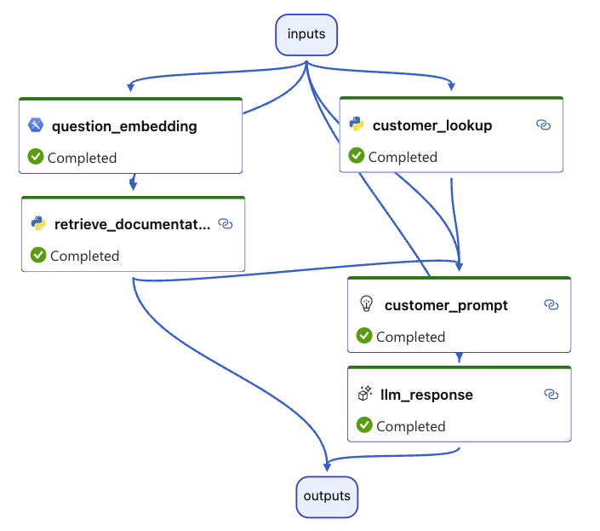
VS Code によるPrompt Flow
コード・ファーストUX
デザイナー・ファーストUX
Notes:
Now, lets talk about the PF extensions for VS Code
There are two experiences
Code first is defined using YAML
Designer view - DAG = Directed acyclic graph
Access to code important
Version control
Extend with own tools

Slide 14




Azure AI Search ハイブリッド検索
検索クエリ
ハイキングに行くための暖かい防水靴が欲しい
検索サービス
埋め込みを作成する
トレックレディ・トレイルウォーカー・ハイキングシューズは、あなたのアウトドア・アドベンチャーに理想的なパートナーです。
埋め込みを作成する
検索インデックス
[0.031198505, 0.094205155,
0.044205155, 0.019588541,
0.019588541, 0.019588541 …]
[0.023883354, 0.021508986,
0.044205155, 0.019588541,
0.031198505, …]
検索結果
ハイブリッド・ベクトルとキーワード検索
1 - トレイルウォーカー・ハイキングシューズ
2 - トレックハイカー・ウォーキングブーツ
BRK404: 埋め込み
Notes:
Before we head to the first demo
We’ll be using 2 data sources for grounding our LLM app: Customer data from Cosmos DB, Product data from Azure AI Search
AI Search support Vector and Semantic Search which is a powerful way to retrieval relevant data.
Most RAG solutions will use a vector store because of it’s semantic search capabilities
User question is: I need warm waterproof shoes to go on a hike.
And I want to talk through how vector search works
We’ll be using text-embedding-ada-002 embedding model, creates a semantic representation of the product description
Click through the slide animation: Index your data, store embeddings and keywords -> User query, gen embedding, pass embedding and question to index, perform a nearest neighbour vector and keyword search -> process results
Vector stores enable semantic/intent query capabilities
Provide embedding which is a semantic representation of the users question
Index to existing structure and unstructured data as well as providing semantic or intent based search
Others: Pinecone, Redis, Weaviate (https://cookbook.openai.com/examples/vector_databases/readme)

Slide 15
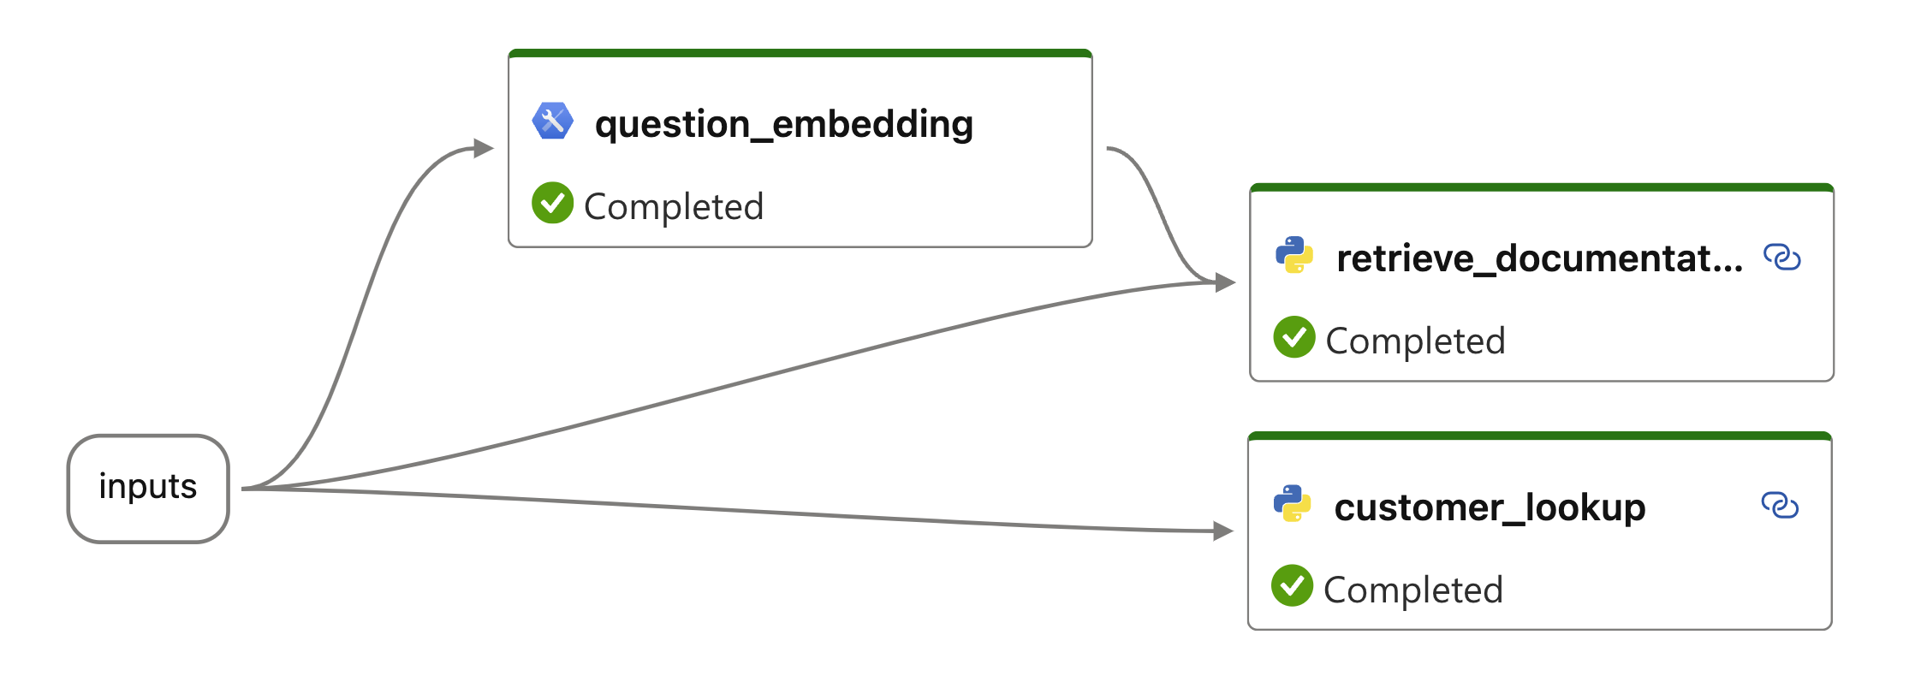
Prompt Flow： RAG の R は Retrieval (検索)
Notes:
Demo 1:
The R in RAG
Create a hello world example
Add a couple of tools connect
But don’t run

Slide 16
デモ
Prompt Flow 検索
https://aka.ms/prompt-flow-e2e
Notes:
Demo 1:
Putting the R in RAG
Explore the data sources from the Azure Portal
Cosmos DB
Azure AI Search
In the Search index – search for `what tents can you recommend for beginners?`
Review the record – note the content_embedding column
Switch to VS Code
Create a new folder
Switch to design mode
Create a chat flow
Demo UI, PF Extension, FLOWS, TOOLS, CONNECTION
Add the Embedding tool and link to the question
Switch back to code mode and paste in code for first demo
Switch back to design mode
DAG Tools to resize, toggle the orientation etc
Run and discuss the results of the data sources

Slide 17
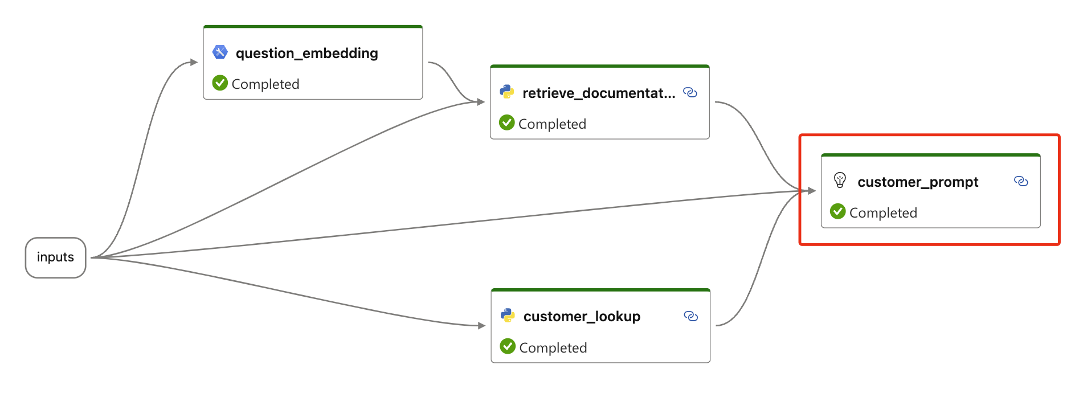
Prompt Flow：RAG の A は Augmentation (拡張)
Notes:
Meta Prompty

Slide 18
デモ
Prompt Flow 拡張
https://aka.ms/prompt-flow-e2e
Notes:
Putting the A Augment in RAG
-Setup env
- ai studio and catalog
-Create azure resources and connections in pf
-Intro vs code and code first features
-Build chat pf from scratch, show data creation etc, walk thru support prompt flow

Slide 19
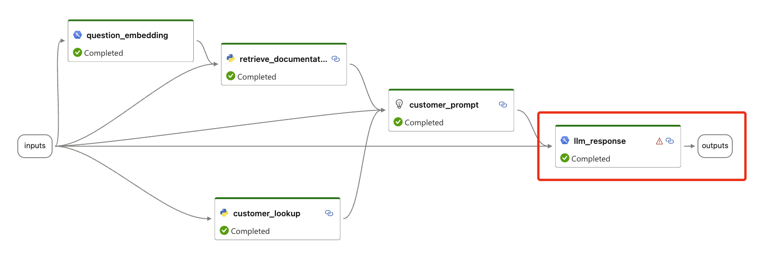
Prompt Flow：RAG の G は Generation (生成)
Notes:
Putting the G Generative in RAG

Slide 20
デモ
Prompt Flow 生成
https://aka.ms/prompt-flow-e2e
Notes:
Putting the G Generative in RAG
-Setup env
- ai studio and catalog
-Create azure resources and connections in pf
-Intro vs code and code first features
-Build chat pf from scratch, show data creation etc, walk thru support prompt flow

Slide 21

評価指標
根拠
関連性
一貫性
モデルが生成した回答が、入力ソースからの情報とどの程度一致しているかを測定
モデルが生成した回答が、どの程度適切で、与えられた質問に直接関連しているかを測定
言語モデルが、スムーズで、自然に、人間の言葉に似た出力をどの程度生成できるかを評価
Notes:
Basic intro to evaluations
Groundedness – truth
Relevance – related to questions
Coherence – resembles human like language
Experiment framework -
We ask GPT-4 – not using in product is because it’s slow and expensive

Slide 22
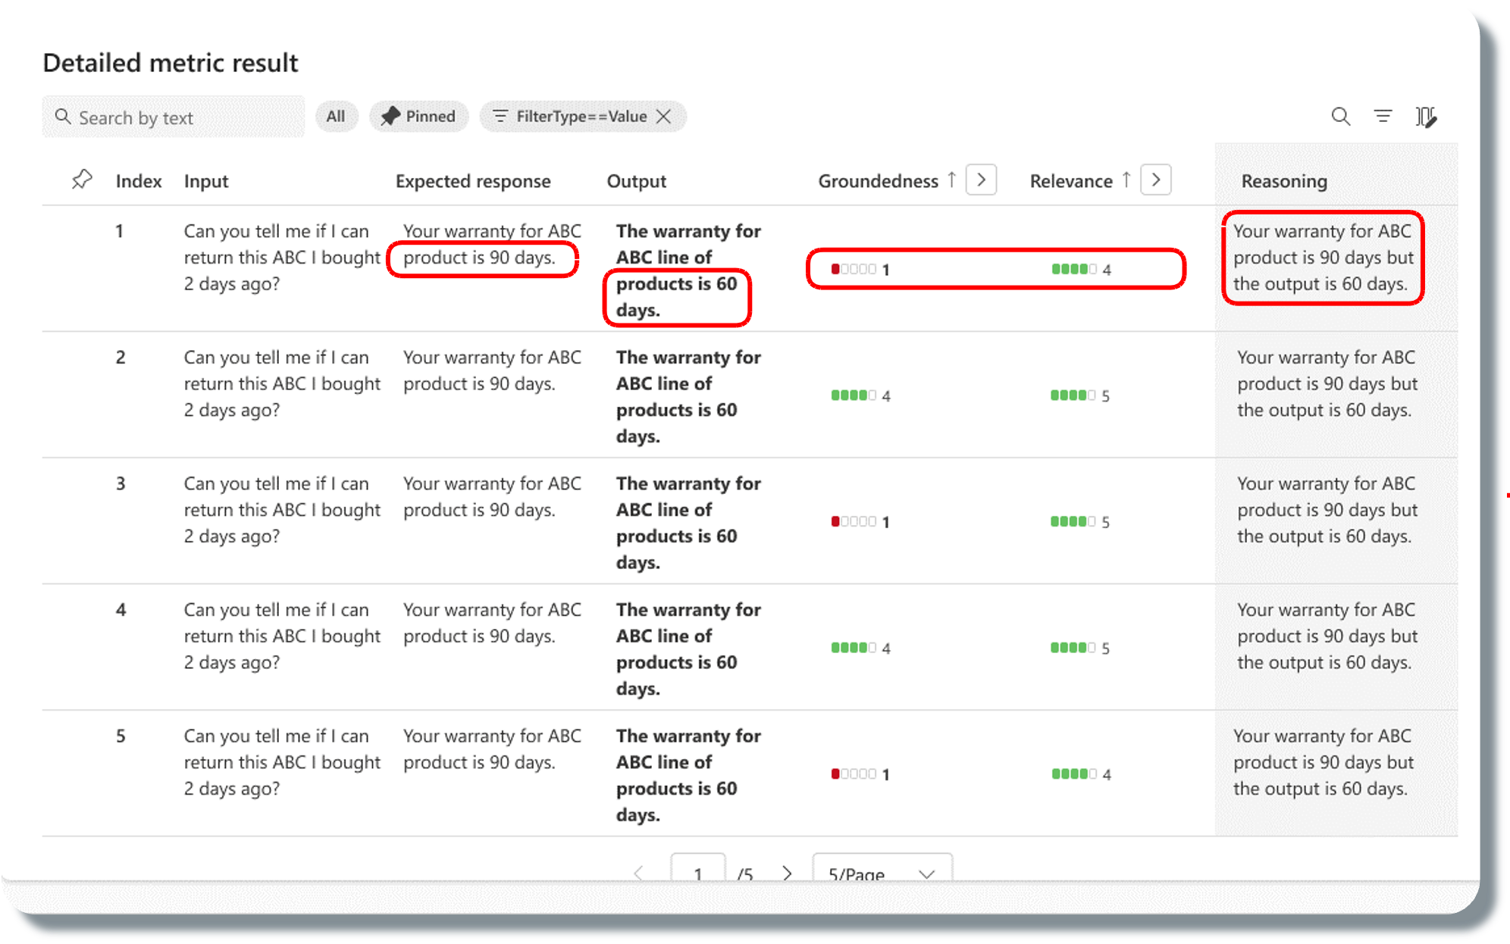
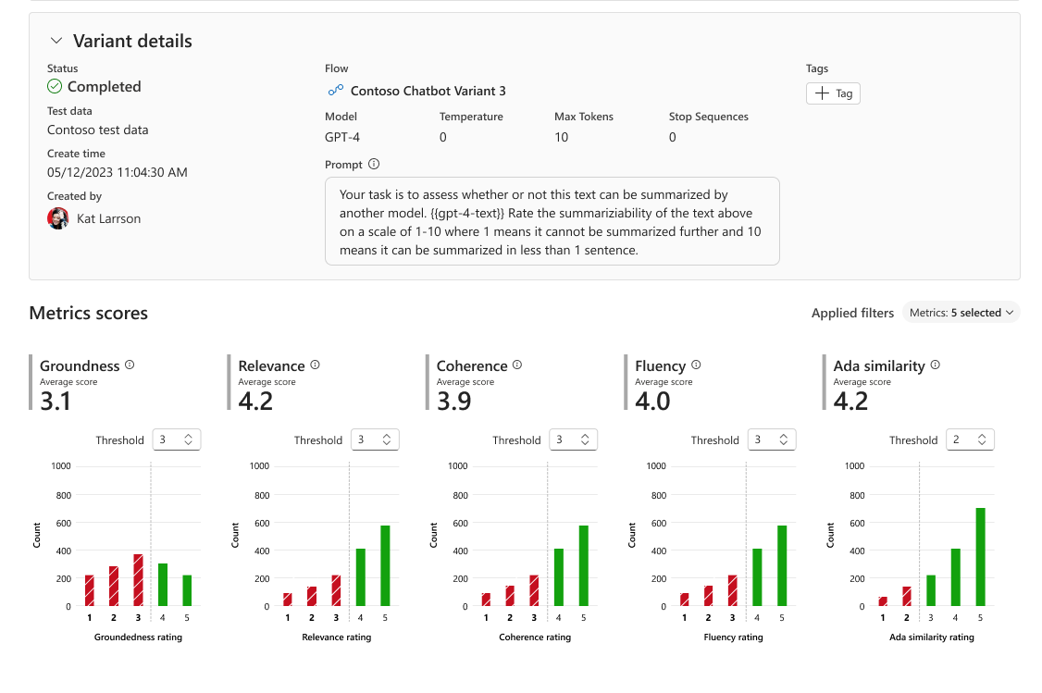
評価ツール
Orchestrate existing APIs, data stores, and models
Evaluate capabilities, cost, latency, & compatibility
Notes:
It gives you complete tools to be able to understand the behavior of the graph of models and APIs that you're calling. To be able to evaluate the outputs.
These models are very non deterministic and so evaluation is at the heart of how you actually make sure it's doing the right thing.

Slide 23
デモ
根拠評価
Notes:
-Show simple eval that only has groundedness
-Push flows to cloud with cli

Slide 24
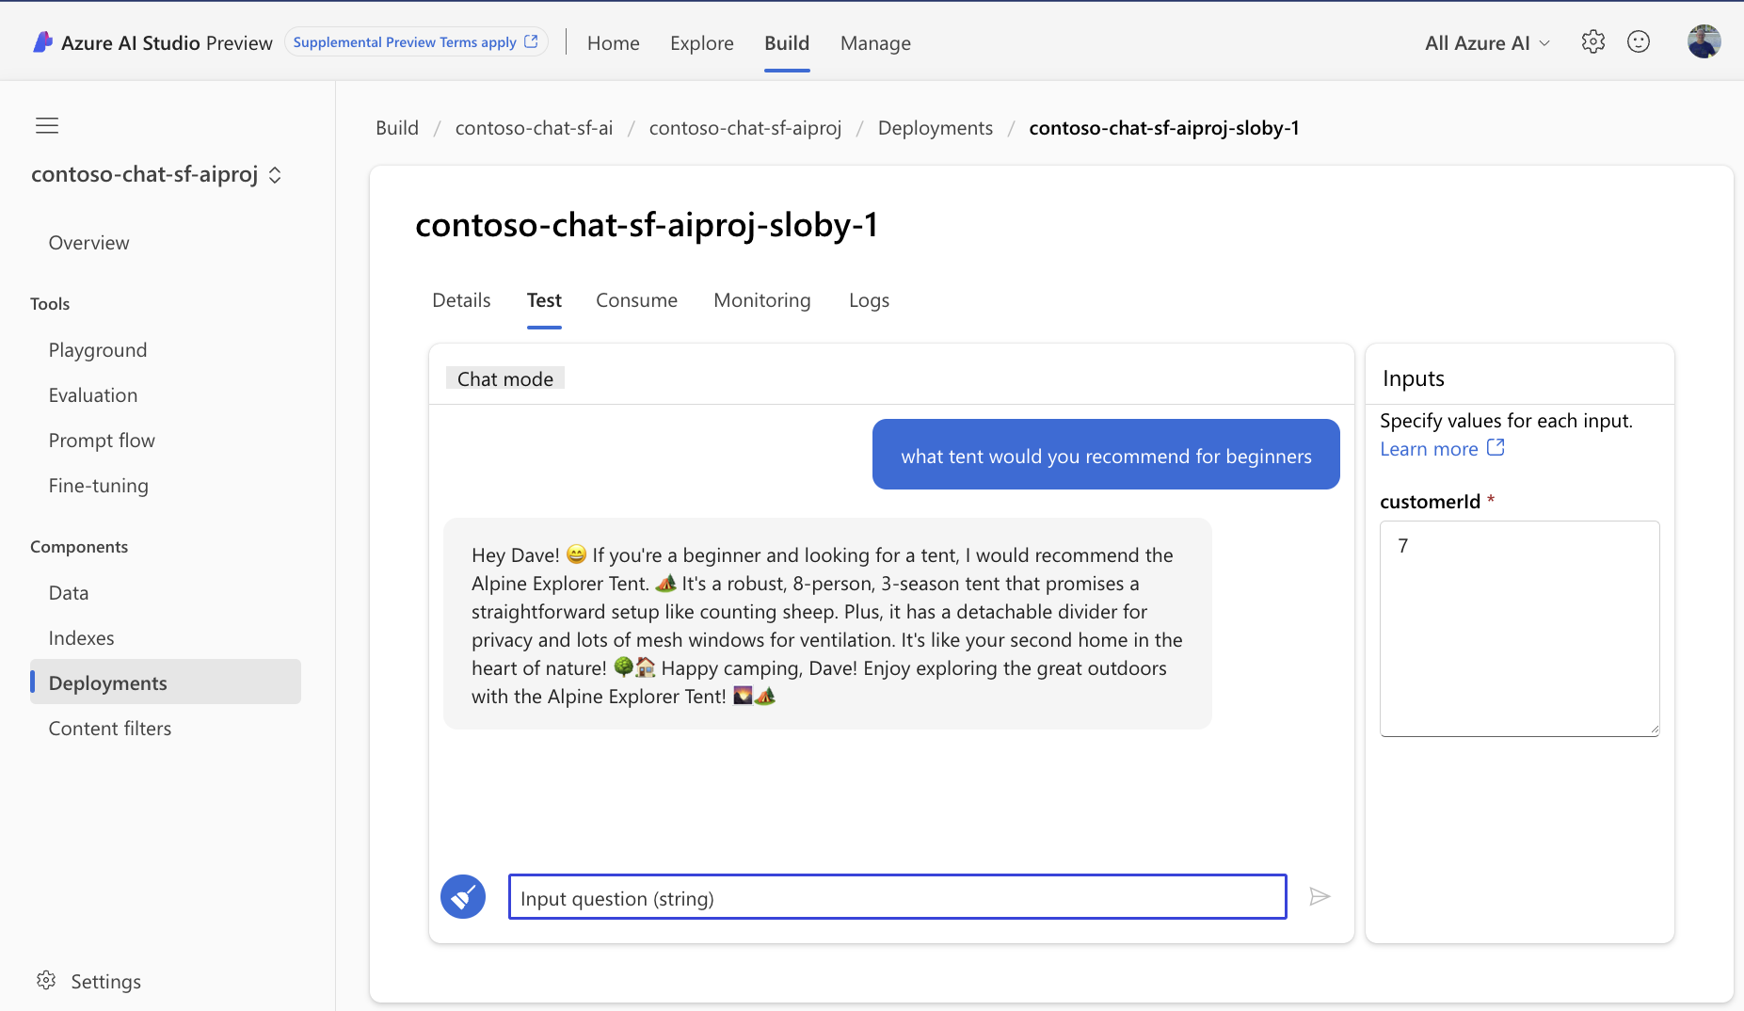
Azure AI Studio： テストデプロイメント
Notes:
Basic intro to evals
Groundedness – truth
Relevance – related to questions
Coherence – resembles human like language
Experiment framework -
We ask GPT-4 – not using in product is because it’s slow and expensive

Slide 25
LLM ライフサイクルの活用事例
管理
アプリ展開の準備
プロジェクトの推進
プロンプト エンジニアリングまたは微調整
LLM を探す
取得拡張生成 (RAG)
クォータとコスト管理
安全なロールアウト/ステージング
プロンプトを試す
ビジネス ニーズ
仮説
監視
LLM アプリ/UI の展開
アイデア/ 探索
例外処理
構築/強化
運用化
評価
コンテンツ フィルタリング
プロジェクトを元に戻す
フィードバックを提供する
Notes:
LLMOps is for a new class of LLM Apps. Combination of platform, models, tools, frameworks, best practices
Lots of hard complex problems, and a lot of ongoing research to solve challenges.
We’ve identified 3 phases based on our experiences and customer feedback
Exploring ideas, Model selection, Prompt engineering fits hypothesis
The Building phase to ensuring app quality, hallucinations, performance, customer intent (chat or support), content safety and organization reputation
Operationalizing, Monitoring costs, prompt and response drift and model performance
Wrapped in a Management fabric and set of tools, for eg tools for ci/cd pipelines, enterprise and network security, governance your organization expects

Slide 26
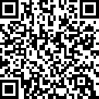
https://aka.ms/aitour/contoso-chat
Check out the source code for this demo here:

Slide 27
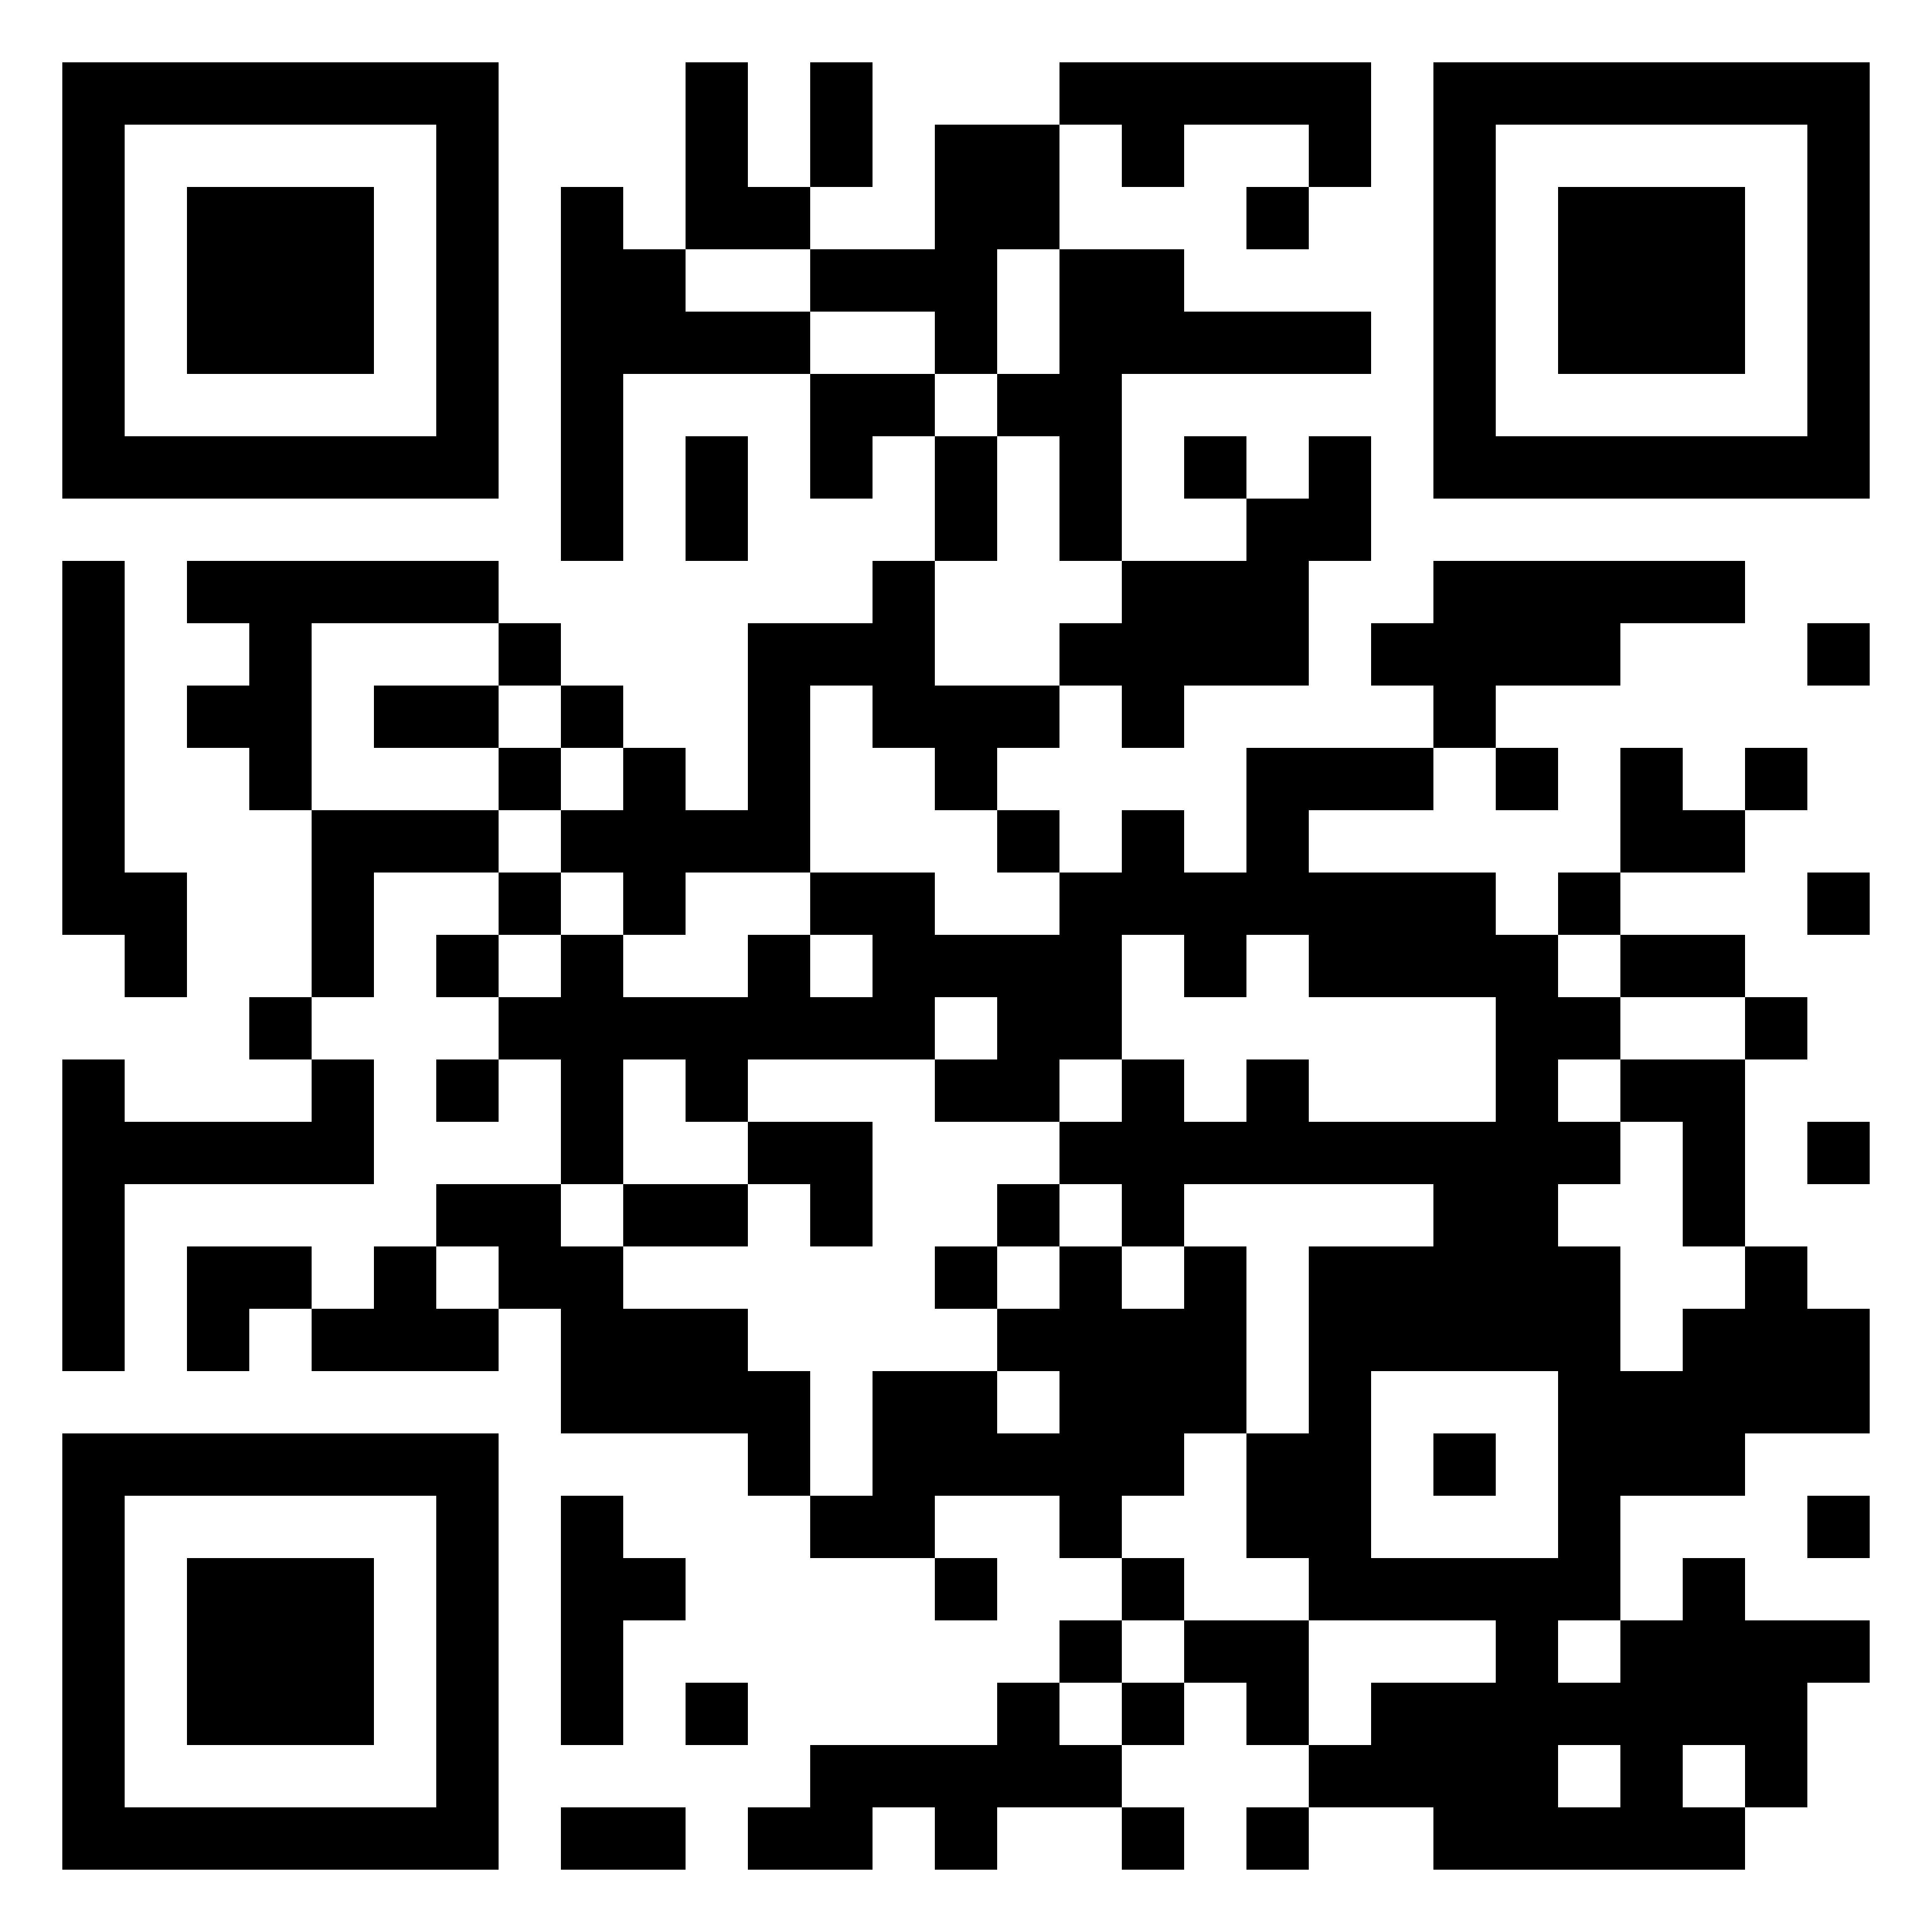
ありがとう！
Dave Glover | Microsoft | Principal Cloud Advocate
https://aka.ms/aitour/contoso-chat
LinkedIn: gloveboxes

Slide 28
Microsoft Learn で AI スキルの習得を始めよう
AI スキルを身につけ、コミュニティとつながり、マイクロソフト認定資格を取得し、エキスパートから学び、クラウドスキルチャレンジに挑戦しましょう。
aka.ms/LearnAtAITour
Notes:
Build your AI skills, connect with the community, earn Microsoft certifications, learn from the experts, and take the Cloud Skills Challenge.

Slide 29
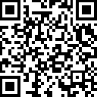
Join the Azure AI Community on Discord
参加者同士、もしくはマイクロソフトの
エキスパート、MVP の皆様と交流し、
ご興味のあるセッションについて参加し、
AI に関する議論を深掘りしましょう。
aka.ms/AzureAI/Discord
Notes:
Participants will have the opportunity to interact with each other and with Microsoft's
and MVPs, and to interact with each other and with Microsoft experts and MVPs,
and participate in the sessions that interest you,
and discuss AI in depth.

Slide 30
UPCOMING SESSIONS:
BRK411 LLMOpsによる迅速なエンジニアリングから生産まで
4:30 PM
WRK451 プロダクションレベルのRAGワークフローの開発 | Dave Glover David Smith
4:00 PM

Slide 31
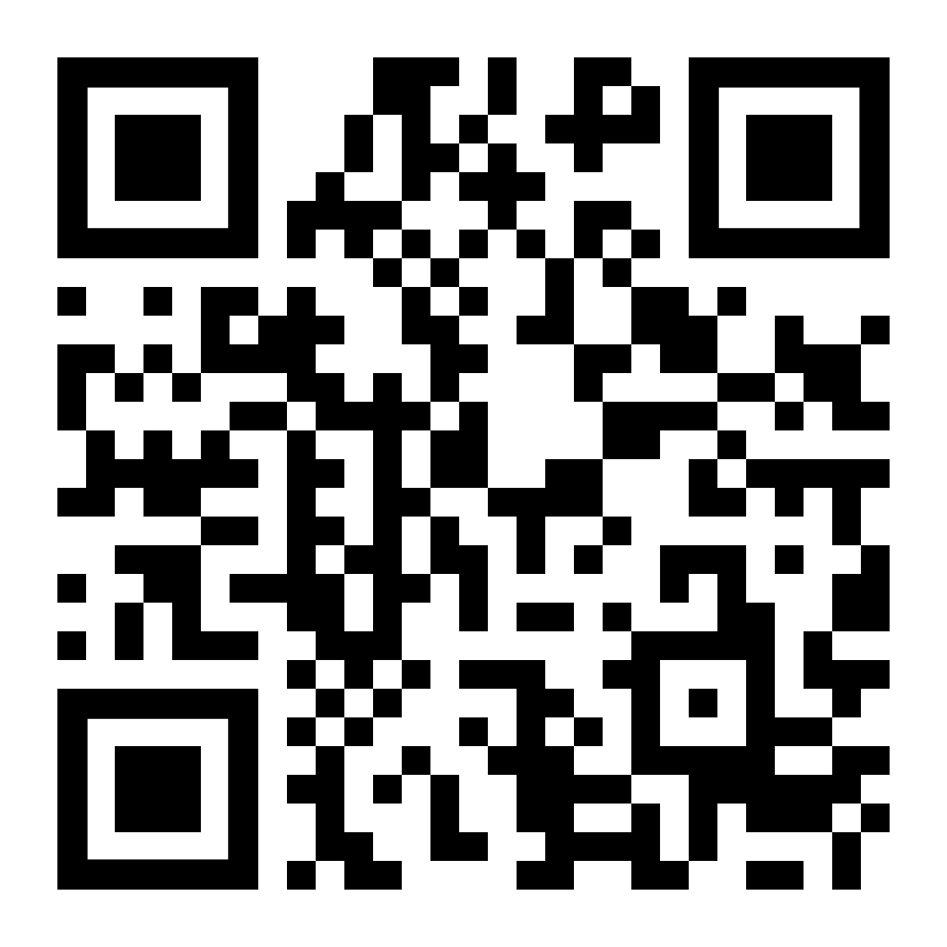
アンケートご協力のお願い
本イベントについてのご意見・ご感想を 下記よりご回答ください。
https://aka.ms/MicrosoftAITour/Survey
こちらの QR コードからもご回答いただけます。
Scan QR code to respond

